Slide 1
Mask Detection
Project Guide:
Mrs Manasa vavilapalli
-121710318057(Mahesh)
-121710318055(Sai Rao)
-121710318039(Dharmesh)
-121710318013(Dinesh)

Slide 2
Abstract:
Nowadays, Machine learning is developing very fastly. Almost in every sector machine learning is used. And it is an application of artificial intelligence where available information is used through algorithms to process or assist the processing of statistical data. While Machine Learning involves concepts of automation, it requires human guidance.
The proposed project is on Mask detection. Here we used Convolutional neural networks(CNN) from deep learning and used MobileNetv2 architecture. And we used some of the modules like Tensorflow, Keras, Opencv

Slide 3
Problem statement:
Due to this covid-19. Our lives has changed completely. We are leading a new normal. And while going out wearing mask is compulsory. But many people are not wearing masks properly. Due to this problem many people will be in danger. Machine learning can solve this problem. So we used concepts of machine learning and created mask detector and we can implement this mask detector in the places where the movement of people is high like shopping malls,medical stores, temples etc.
Uber cars are trying to implement this technology in their application. Otp for ride is given only after the passenger wearing a mask

Slide 4
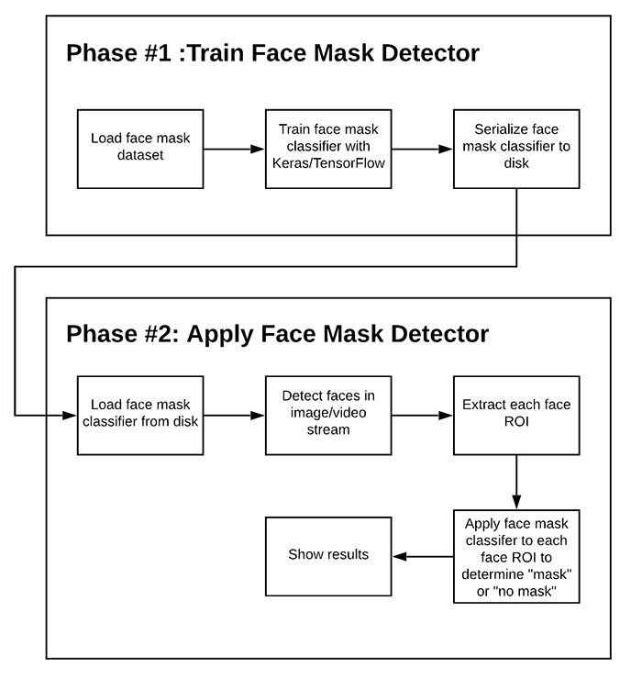
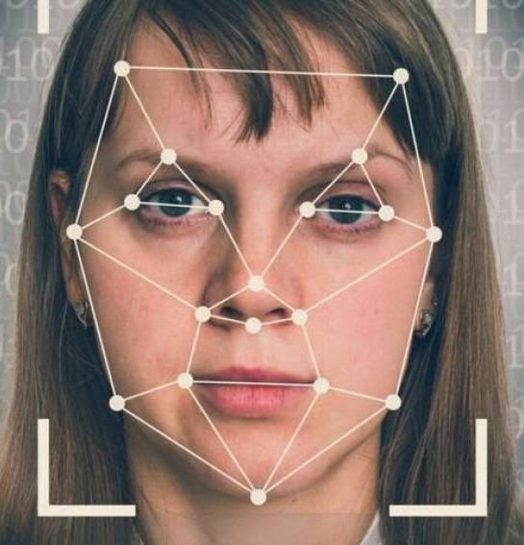
Flowchart:

Slide 5
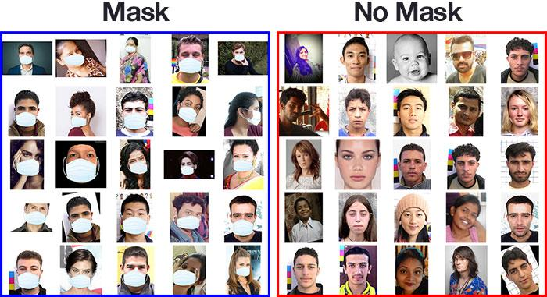
DataSets:
Here you can see Our data sets of Mask and Without Mask. Using these datasets we gave training to our algorithm .

Slide 6
In order to train a custom face mask detector, we need to break our project into two distinct phases, each with its own respective sub-steps (as shown in the flowchart).
Training: Here we’ll focus on loading our face mask detection dataset from disk, training a model (using Keras/TensorFlow) on this dataset, and then serializing the face mask detector to disk
Deployment: Once the face mask detector is trained, we can then move on to loading the mask detector, performing face detection, and then classifying each face as Mask or No Mask

Slide 7
Architecture:
In our project we took MobilenetV2 model. As it is very light weight model it saves computational cost and It is highly efficient architecture which can be applied to embedded devices with limited computational capacity
For example:Raspberry pi, mobile applications,Google coral, Nvidia,etc

Slide 8
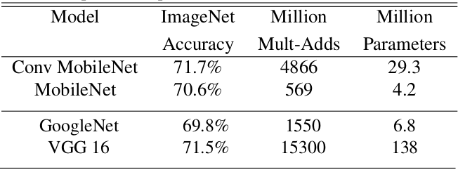
As you can see the parameters of the MOBILENET model. It has only 4.2 Million parameters makes the model less complex. We can also observe VGG16, GOOGLENET CONV models. They have more number of parameters making the model more complex. Even with the less parameters Mobilenet model achieves 70.6% accuracy which was equivalent to other models.

Slide 9
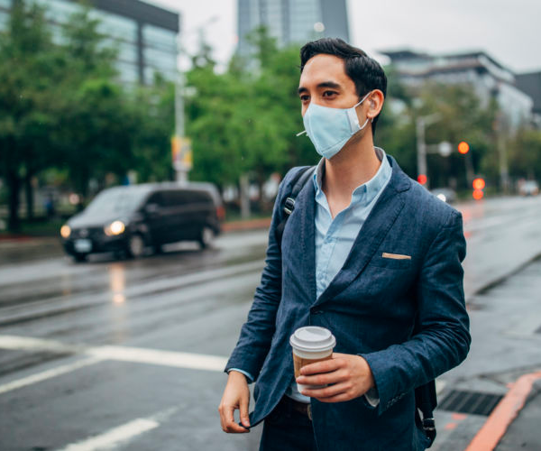
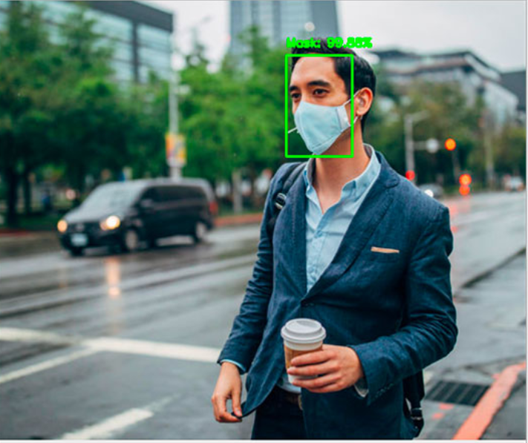
Implementing our COVID-19 face mask detector for images
First we need to upload an image from the disk.
Detects the face in image
Applies our model and classifies as Mask or Without mask.

Slide 10
Implementing our COVID-19 face mask detector in Video Streams
Image detection for video is similar to that of detection in images.
Here instead of uploading an image. A frame is created and a continuous loop is created. So the frame will detect the face and checks the mask and percentage of mask is displayed over the frame.
In both the videostream and image, multiple faces can be detected and detect the masks over their faces.

Slide 11
THANK YOU

